Slide 2
Modeling the Effects of Seasonality and its Impact on the Transmission Dynamics of the Zika Virus
Rylee Esplin
Advisor: Dr. Vinodh Chellamuthu
Department of Mathematics
Notes:
Hi guys, my name is Rylee Esplin and my advisor is Dr Vindoh Chellamuthu. today I will be talking about the research project I have been working on for a few months now titled Modeling the Effects of seasonality and its impact on the transmission dynamics of the Zika Virus.

Slide 3
overview
Background
Model
Results
Conclusion and Further Research
Notes:
Ok so, I will start with an overview of what I will be going over today. I will first give you a little back ground on what the Zika Virus is, next I will go into the goals of my model and the actual model I have created. Then I will show you the results of my model and finally the conclusion I have drawn and further research that I would like to do on this project.

Slide 4
Background of ZIkV
The Zika Virus (ZIKV) is a mosquito-borne disease that inhabits Aedes Aegypti mosquitoes.
This disease is unique. It can be passed to humans three different ways:
first, through the bite of an infected mosquito;
second, sexual transmission between humans who are already infected with the disease; and
from humans to their unborn children through vertical transmission.
ZIKV has been shown to cause Microcephaly in babies when the mother
had ZIKV while pregnant or shortly before getting pregnant.
Several studies have shown the dynamics of ZIKV is dependent on temperature.
Notes:
The Zika Virus or as I will write it through out my presentation ZIKV inhabits Aedes Aegypti mosquitoes.
This virus is a unique disease compared to west nile virus, dengey fever, or other mosquito borne diseases in the sense that it can infect a human in three possible ways. First is through the bite of a mosquito who has the zika virus.
Next, it can be passed through sexual transmission between humans who are already infected with the disease.
And finally, the most unique transmission, is it can actually be passed from infected mothers to their unborn children.
Because of this vertical transmission between mothers to their unborn children, there is evidence to suggest that the zika virus can cause Microcephaly in babies when the mother has zika while pregnant or had the zika virus shortly before getting pregnant. Microcephaly is a condition where a baby's head is much smaller than normal because of abnormal brain development.
There has also been some studies done that have shown that zika is dependent on temperature, but I will go over this more on the next slides.

Slide 5
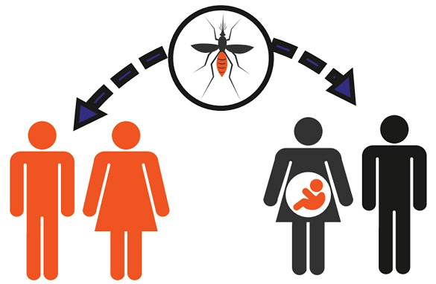
Goals
Find the relationship between temperature and the number of people infected with ZIKV.
How does the transmission of the ZIKV work:
mosquito to person.
person to person
mother to unborn child
[4]
Notes:
Here are some of the goals I wanted to complete through this project
First, and the most important is I wanted to find the relationship between temperature and the number of people who are getting infected with the Virus each year. A lot of the research that is being done with the Zika virus at this time does not include temperature as a variable in the transmission dynamics. As I said in the last slide, there is evidence that suggests temperature does play a role in the transmission of Zika so I wanted to see how important it really was.
I also wanted to see, with this temperature variable included, how does the transmission of the zika virus work between mosquito to person, person to person, as well as mother to unborn child.

Slide 6
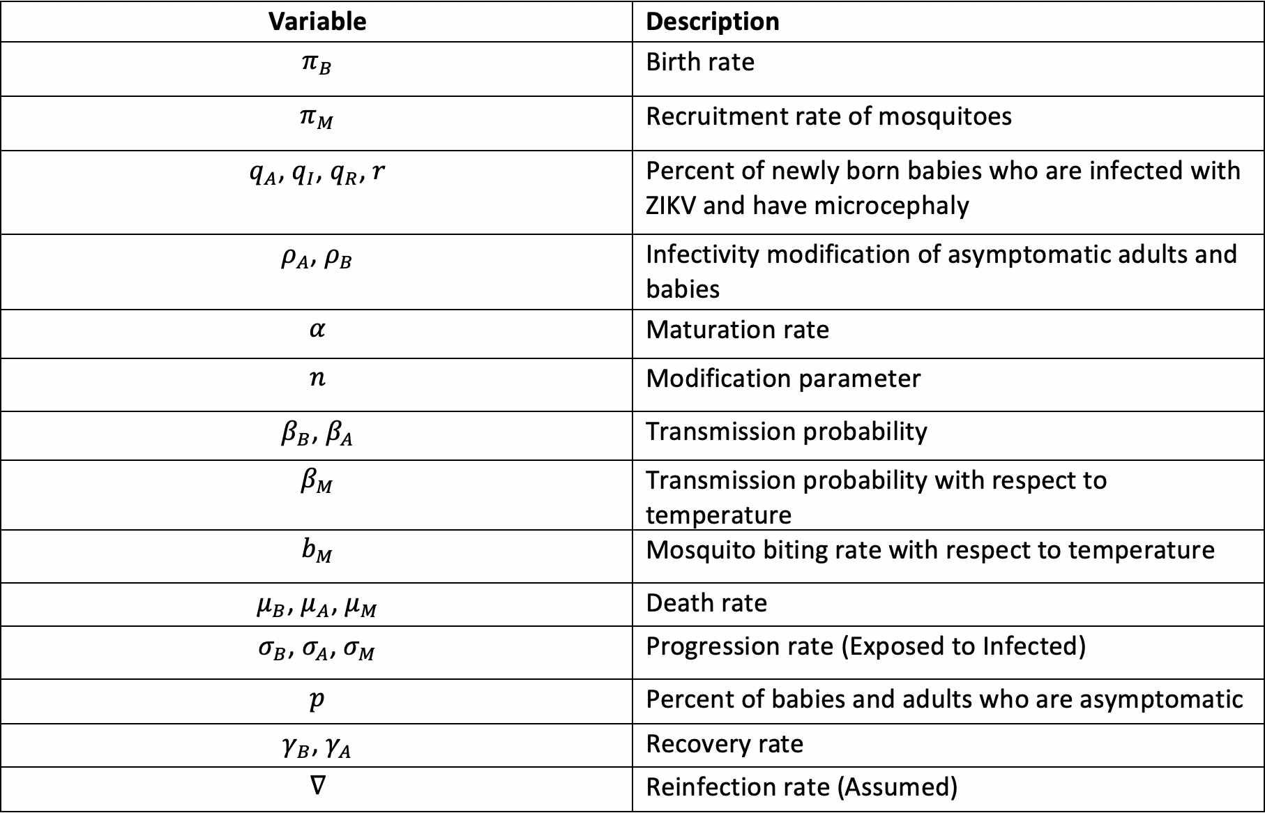
Variables
Notes:
As you can see from this chart there are a lot of variables that are involved in this research. Because the transmission of the ZIKV is so unique we need to incorporate all of these different variables. Some of the variables we included are pi sub b which is the birth rate of humans and we also included pi sub M which is the recruitment rate of mosquitoes. We have also incorporated death rate of babies, adults, and mosquitoes, the recovery rate, and a reinfection rate. We have also included Beta sub M and b sub m. beta sub M is the transmission probability of mosquitoes to human and b sub M is the biting rate of mosquitoes. These are both function of time with respect to temperature. These are very important variables because depending on the temperature, it will increase or decrease these variables.

Slide 7
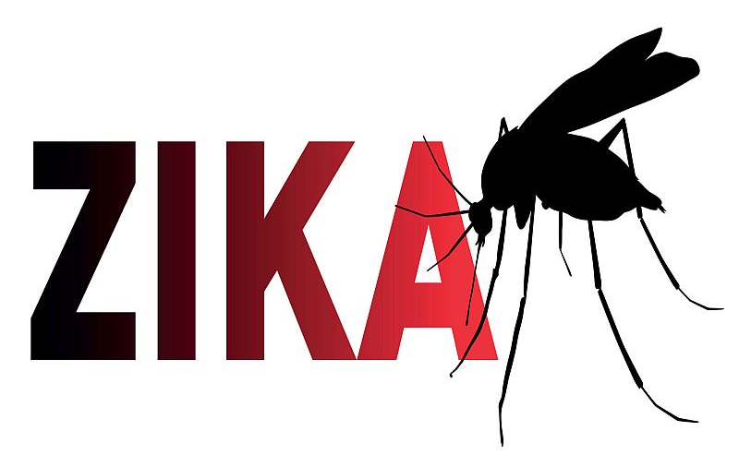
assumptions
We have assumed that people are not immune to ZIKV and thus can get reinfected with the virus.
[5]
Notes:
So the one main assumption we made when developing this model is the reinfection rate. There has yet to be any sound scientific evidence that says whether or not a person can get the zika virus twice so we have assumed that a person can for the purpose of our results and more telling graphs.

Slide 8
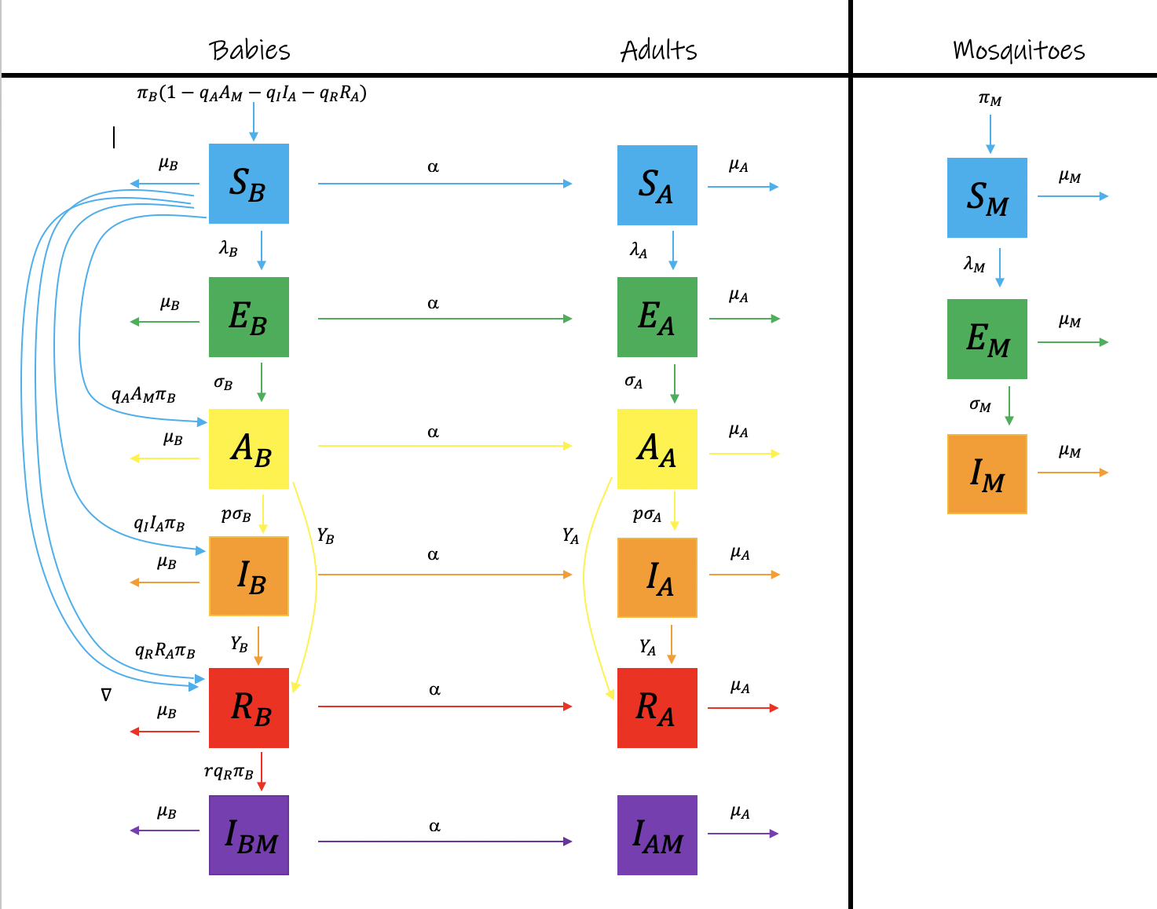
Flow Diagram
Notes:
Option 2:
Here I have a flow diagram of how our model works. We are using compartmental modeling. The blue is the susceptible populations, green is the exposed, yellow is asymptomatic, orange is infected, red is recovered, and purple is the population infected with microcephaly. These are all for babies, adults and mosquitoes. We are moving people from compartment to compartment. For example as you can see we have are moving some number of people from the susceptible baby compartment to the susceptible adults compartment by a rate of alpha. Alpha, if you recall is the maturation parameter. So as susceptible babies are maturing to adulthood, they move to the susceptible adult compartment. Also, if we look at the mosquito flow diagrams. Mosquitoes are going into the susceptible mosquito compartment. From here some number of mosquitoes are dying and leaving the susceptible compartment and some are then exposed to the virus so they then move to the exposed category. Once in the exposed category these mosquitoes can again die by natural causes and some move to the infected category at some rate that the infection progresses. Once a mosquito is infected with a virus they cannot recover, thus they all die. This flow of populations works the same same with the babies and Adults compartments. The main point of these figures is to show how our population of humans and mosquitoes are moving into different compartments as the Zika virus is spreading.

Slide 9
Equations
$$\frac{{dS}_{B}}{dt}=π_{B}\left(1−q_{A}A_{A}−q_{I}I_{A}−q_{R}R_{A}\right)−\left(α+λ_{B}+μ_{B}\right)S_{B}+{∇R}_{B}$$
$$\frac{dE_{B}}{dt}=λ_{B}S_{B}−(α+μ_{B}+σ_{B})E_{B}$$
$$\frac{dA_{B}}{dt}=σ_{B}E_{B}+π_{B}q_{A}A_{A}−(μ_{B}+α+γ_{B})A_{B}−pσ_{B}E_{B}$$
$$\frac{dI_{B}}{dt}=pσ_{B}E_{B}+π_{B}q_{I}I_{A}−(α+μ_{B}+γ_{B})I_{B}$$
$\frac{dR_{B}}{dt}=(A_{B}+I_{B})γ_{B}+{(π}_{B}q_{R}−r{π_{B}q}_{R})R_{A}−(α+μ_{B}+∇$)$R_{B}$
$$\frac{dI_{BM}}{dt}=rπ_{B}q_{R}R_{A}−{(μ}_{B}+α)I_{BM}$$
$$\frac{dS_{A}}{dt}=αS_{B}−μ_{A}S_{A}−λ_{A}S_{A}+∇R_{A}$$
$$\frac{dE_{A}}{dt}=λ_{A}S_{A}−μ_{A}E_{A}−σ_{A}E_{A}+αE_{B}$$
$$\frac{dA_{A}}{dt}=σ_{A}E_{A}+αA_{B}−μ_{A}A_{A}−γ_{A}A_{A}−pσ_{A}E_{A}$$
$$\frac{dI_{A}}{dt}=pσ_{A}E_{A}+αI_{B}−μ_{A}I_{A}−γ_{A}I_{A}$$
$$\frac{dR_{A}}{dt}=γ_{A}A_{A}+γ_{A}I_{A}+αR_{B}−μ_{A}R_{A}−∇R_{A}$$
$$\frac{dI_{AM}}{dt}=−μ_{A}I_{AM}+αI_{BM}$$
$$\frac{dS_{M}}{dt}=π_{M}−λ_{M}S_{M}−μ_{M}S_{M}$$
$$\frac{dE_{M}}{dt}=λ_{M}S_{M}−μ_{M}E_{M}−σ_{M}E_{M}$$
$$\frac{dI_{M}}{dt}=σ_{M}E_{M}−μ_{M}I_{M}$$
Notes:
Here are the differential equations we have made. These are split up into the baby, adults, and mosquito equations. So if we look at the first equation which is the susceptible babies equation you can see that we have a negative alpha times susceptible babies, if we look to the right of that equation over to our susceptible adult equation you can see the we have a positive alpha time susceptible babies. That term represents the number of susceptible children who have matured and thus are now in the susceptible adult category. Also, if we look back at the susceptible baby category, we have a positive nabla which represents reinfection multiplied by R_B which represents recovered babies. If you look down to the recovered babies category we can see a negative nabla R sub b. So, we are removing some number of people who have recovered from the zika virus back into the suspectable category because we have assumed that reinfection can happen. This is just a little example of how these equations work. We are moving people from one compartment to another.

Slide 10
Results
Notes:
Ok so now its time for some results! I have calculated and graphed these equations with real world temperature data from Thailand. I chose Thailand because they have a constant temperature all year long.

Slide 11
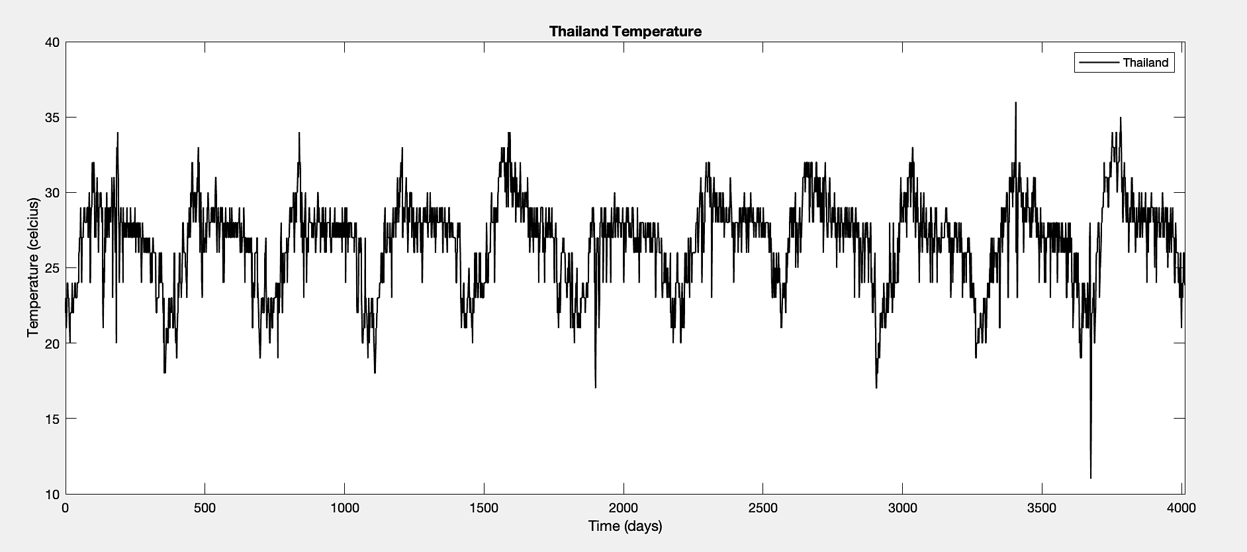
Real World Temperature
Notes:
Research suggests that temperature plays a role in the transmission of ZIKV., however most ZIKV related research does not include temperature as a variable. Mosquitoes are most active between 21 C and 32 C. AS we can see from the temperature in Thailand over an 11 year period is that there temperatures are almost always in the that temperature range, thus ZIKV should be active in this area.

Slide 12
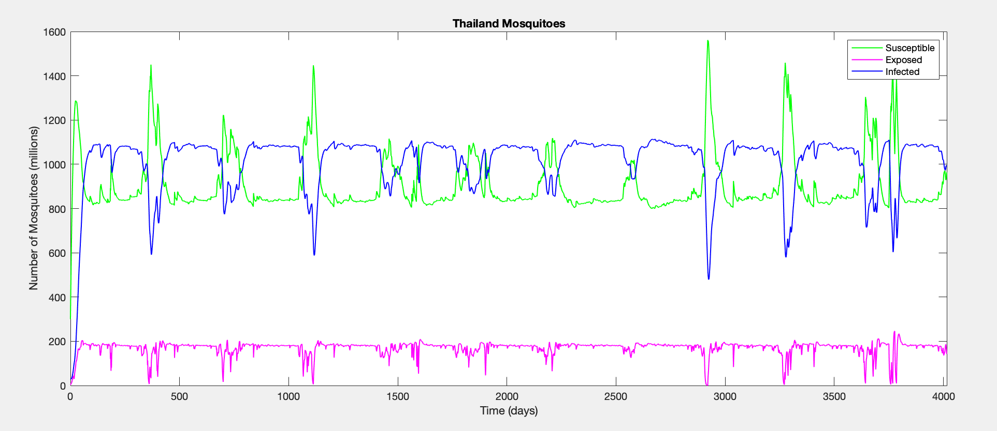
Temperature Effects on ZIKV
Notes:
This graph focuses on how many mosquitoes are susceptible to the virus which is the green line, how many have been exposed to the virus which is the pink line, and how many mosquitoes are actually infected with the virus which is the blue line. As you can see, basically all year long mosquitoes are susceptible to the disease and thus are getting infected.
We can see from this graph that in warmer months, the number of susceptible mosquitos goes down as the number of infected and exposed mosquitoes goes up. This is all because of the influence of temperature on the zika virus

Slide 13
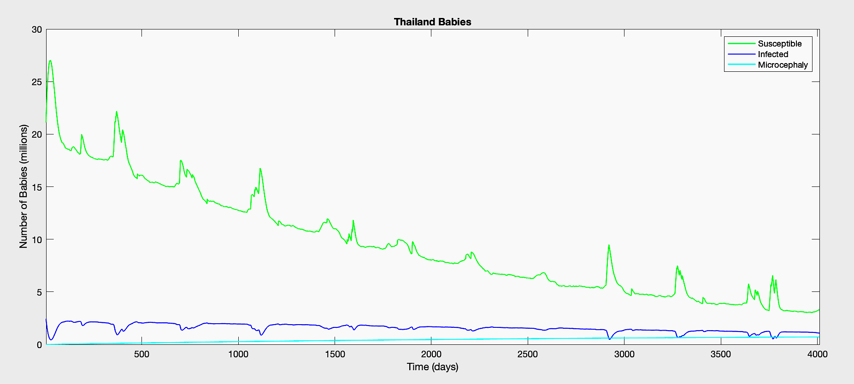
Babies
Notes:
The unique part about the Zika Virus is the fact that it can transfer from mothers to their unborn babies. One side effect, as I have talked about earlier, are microcephaly which is a condition where a baby's head is smaller because of abnormal brain development. This graphs compares the number of babies that are susceptible to ZIKV which is the green line, the number of babies infected with ZIKV but do not have microcephaly which is the blue line, and the number of babies who have microcephaly which is the light blue line. As you can see, the number of cases of microcephaly are pretty constant across the graph. This is because depending on the severity of the condition, they do not mature to adulthood.

Slide 14
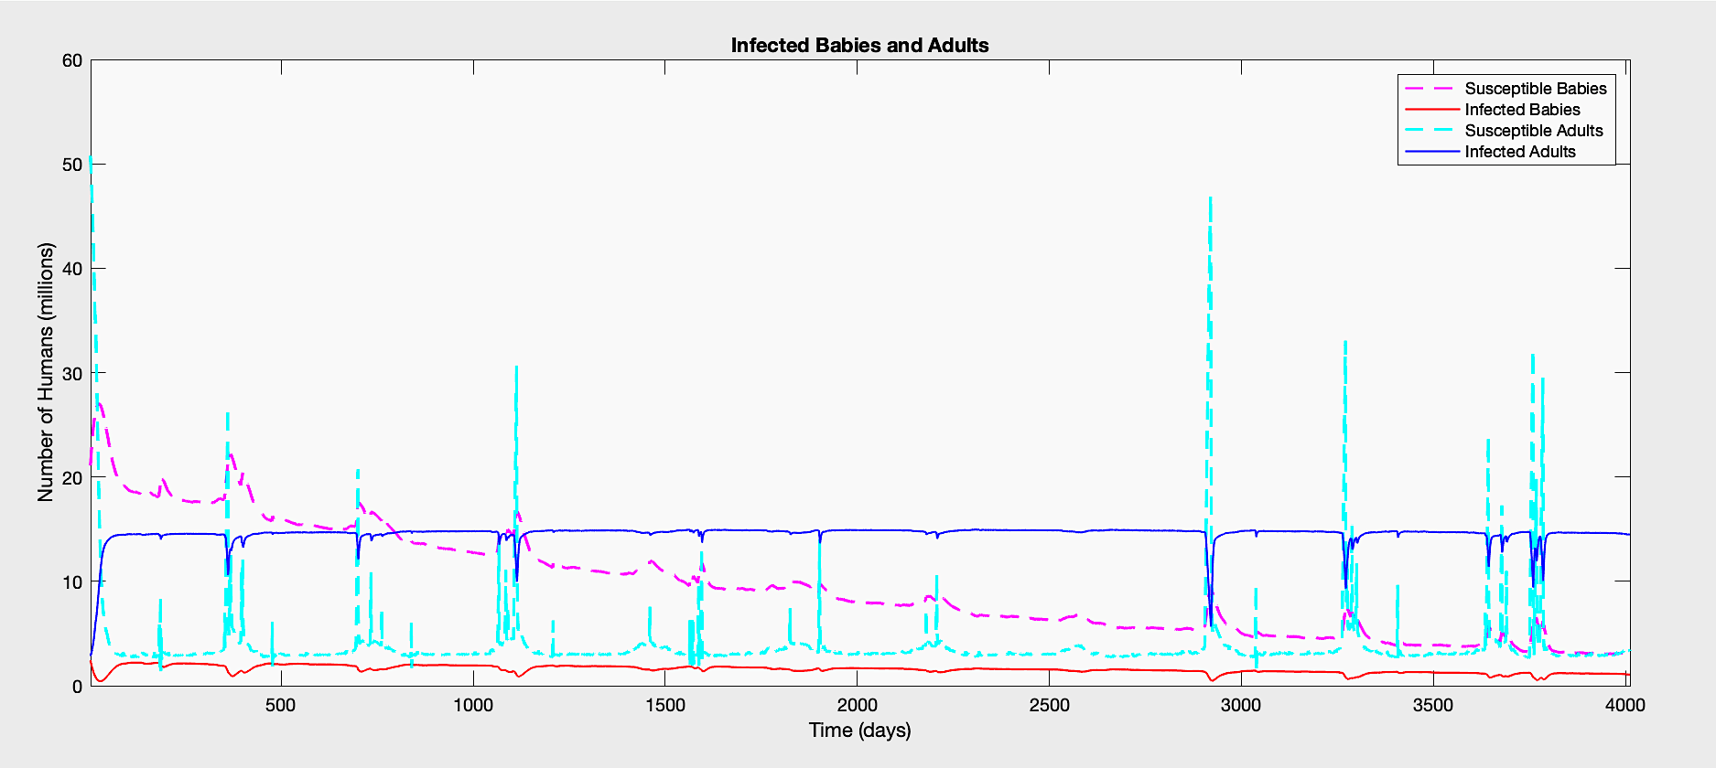
Babies & Humans
Notes:
This graph shows the relationship between susceptible babies which is the dotted pink line to infected babies with is the red line. As well as compares susceptible adults which is the dotted light blue line to infected adults which is this blue line. From the graph you can see that more adults get infected with the the zika virus than babies. You may also notice a decline in the susceptible baby population and an increase in the susceptible adult populations. This is because children are maturing to adults and thus going to adult compartments.

Slide 15
Conclusion and Future work
Our model is unique in the sense it accounts explicitly for temperature effects and confirms the importance of temperature in ZIKV dynamics.
In future work I would like to develop a more robust code that is easily adaptable to different parameters.
Also, this model should be furthered to include temperature from locations such as Brazil and St. George, Utah.
Notes:
From the results we have gathered it confirms that temperature is an important factor in the Zika virus dynamics. When the temperature is between 21 and 32 degrees Celsius, mosquitoes are more active and the zika virus spreads even more.
There is some future would that I would like to do on this project. I would like to work on my equations and code more to develop a more robust model that is easily adaptable to different parameters.
I would also like to gather more real world temperature data from areas like brazil as well as here in St George Utah. This way we see how the virus spreads in areas that don’t have such a constant temperature all year round.

Slide 16
References
Agusto, F.B., et al. “Mathematical Model of Zika Virus with Vertical Transmission.” Infectious Disease Modelling, Elsevier, 23 May 2017, www.sciencedirect.com/science/article/pii/S2468042716300483.
“Another Miami Neighborhood Now Zika-Free.” Another Miami Neighborhood Now Zika-Free, Medical Press, 3 Dec. 2016, www.medicalxpress.com/news/2016-12-miami-neighborhood-zika-free.html.
Best, Katharine, and Alan S Perelson. “Mathematical Modeling of within‐Host Zika Virus Dynamics.” Wiley Online Library, John Wiley & Sons, Ltd, 11 Aug. 2018, www.onlinelibrary.wiley.com/doi/full/10.1111/imr.12687.
“Zika Virus Clipart #10179435.” Clipart, www.clipart.email/download/10179435.html.
“Zika Virus.” Centers for Disease Control and Prevention, Centers for Disease Control and Prevention, 20 Nov. 2019, www.cdc.gov/zika/index.html.
Notes:
These are all the references I used.

Slide 17
THANK YOU
Notes:
And I know we are all busy during these uncertain times, so Id like to thank you for taking the time to listen to my project!

